Slide 1
EASystem Electronic Approval System
Stud. 200312503 Cho Daekeun
Software Special Development 1
Prof. Junbeom Yoo
Notes:
As you see // 보는 바와 같이.

Slide 2
Contents
Summary
Object
Planning
Function
Opinion
Notes:
As you see // 보는 바와 같이.

Slide 3
Summary
What is the EASystem?
EASystem(Electronic Approval System) is the one of the groupware.
Off-line Approval system has so much time and has been paralyzed work during deciding officer ‘s absence in the corporation
So corporation is needed On-line Approval system for efficient work.
Notes:
As you see // 보는 바와 같이.

Slide 4
Object
Project objectives
To develop a computerized Approval management software, that provides typical corporation approval functions such as:
Write a draft document and approval the draft document,
Corporation staffs must be able to connect the system by their rank,
Add new staff, Modify staff, Delete staff,
The software should be easy to learn and use, and efficient.
Notes:
As you see // 보는 바와 같이.

Slide 5
Object
Use the OSP(Object Space Process)
What is OSP?
OSP (Object Space Process)
A software process based on RUP
Tailored to SE classes in universities
Characteristics of OSP
1. 3 Stages
2. Iterative : Multiple development cycles
3. Incremental : System grows incrementally as each cycle is completed
4. Architecture : Stage > Cycle > Phase > Activity
Notes:
As you see // 보는 바와 같이.

Slide 6
Planning
Define Draft Plan
Motive and Object :
To develop a computerized Approval management software, that provides typical corporation approval functions
Range
After login, user must be able to write approval document, and send this document,
Add, delete and modify staff,
Use the Notice and Free board,
Send slip,
Notes:
As you see // 보는 바와 같이.

Slide 7
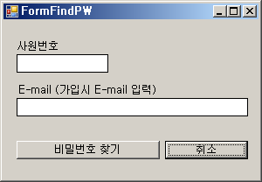
Function
Login Staff
Login Admin
Find Password
Notes:
As you see // 보는 바와 같이.

Slide 8
Function
Login
Login Admin
Notes:
As you see // 보는 바와 같이.

Slide 9
Function
Login
Login staff

Slide 10
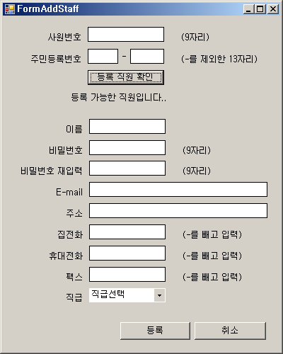
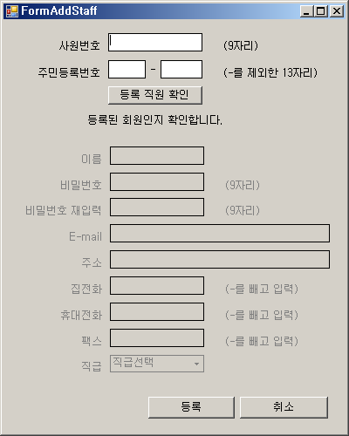
Function
Admin Function
Add Staff
Input
staff number,
citizen number,
Click button
Add OK

Slide 11
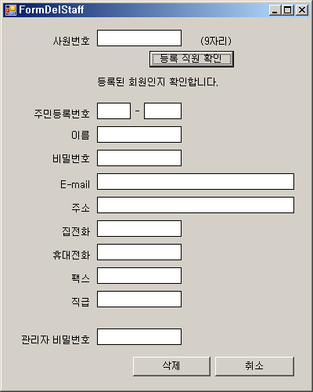
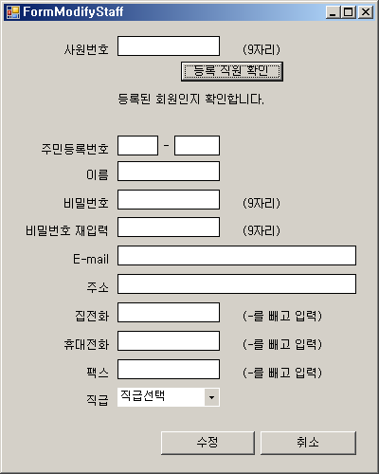
Function
Admin Function
Modify staff
Information
Find Database
Modify OK
Delete Staff

Slide 12
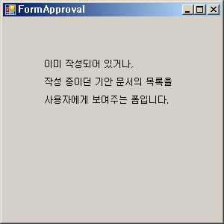
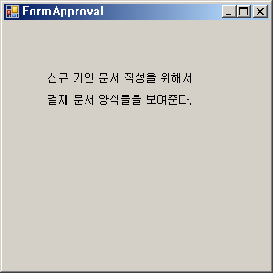
Function
User Function
Write Approval Document
New Approval Document
Edit Approval Document
Save Approval Document

Slide 13
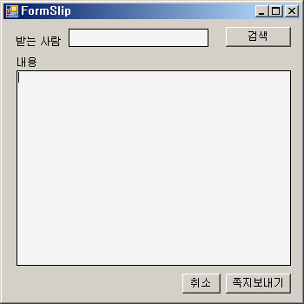
Function
User Function
Slip paper

Slide 14
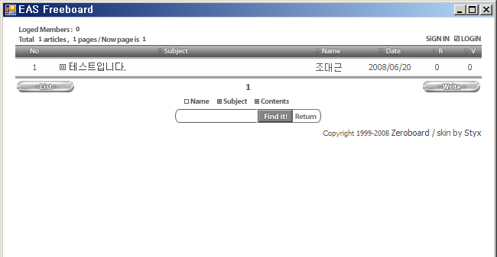
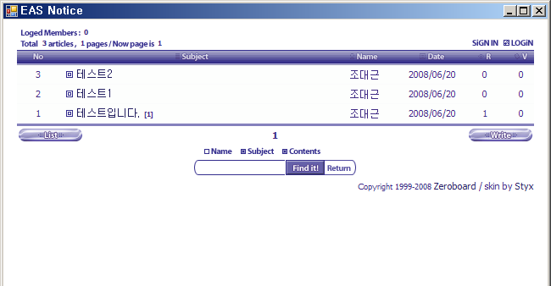
Function
Common Function
Notice Board
Free Board

Slide 15
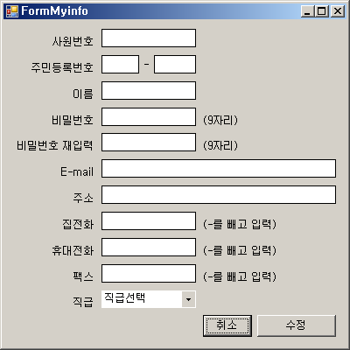
Function
Common Function
My Information Modify

Slide 16
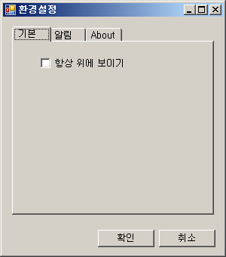
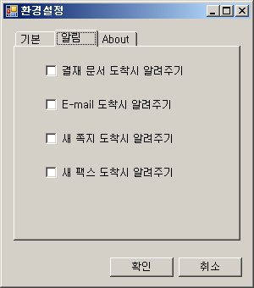
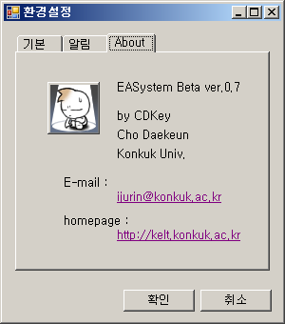
Function
Common Function
Setting
Logout
Exit Program

Slide 17
Opinion
Changed Development Language
Because to connect failed form Function to Database Service-Microsoft SQL Server
Unaccomplished Database Query Language

Slide 18
demo

